Slide 1
Huawei ICT Competition
Student Registration Guide
Security Level:

Slide 2
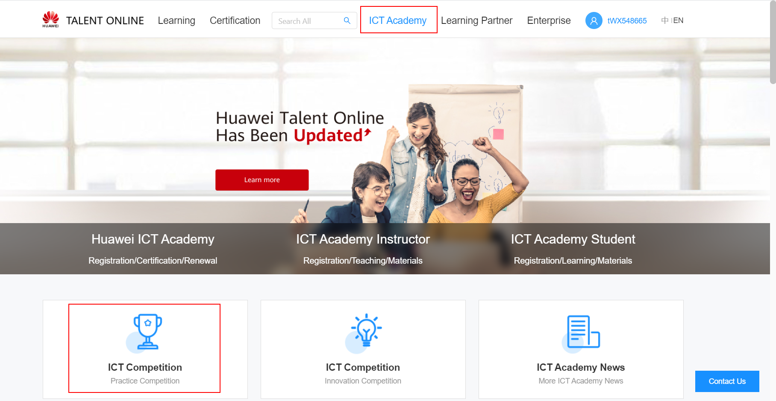
1. Guest visits ICT Competition homepage
① Visit https://e.huawei.com/cn/talent/#/home
② Click “ICT Academy-ICT Competition” to enter the ICT Competition homepage.

Slide 3

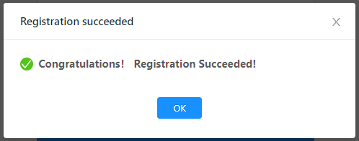
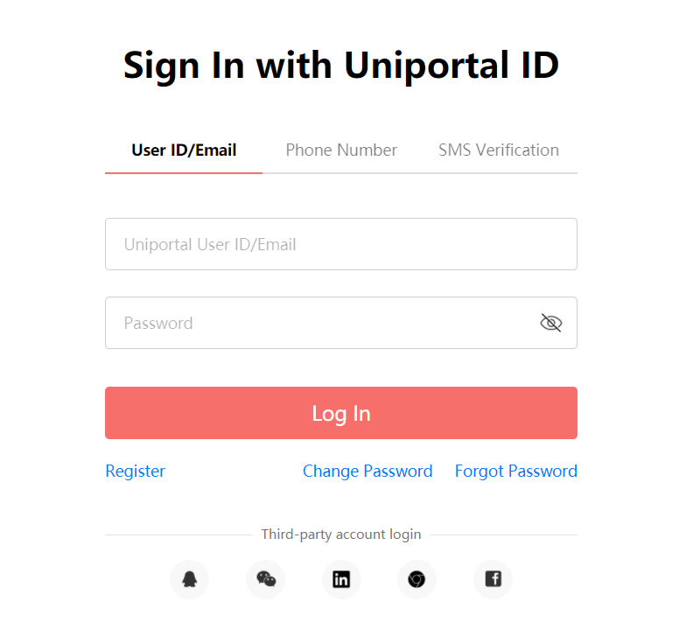
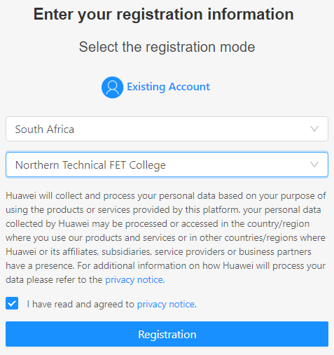
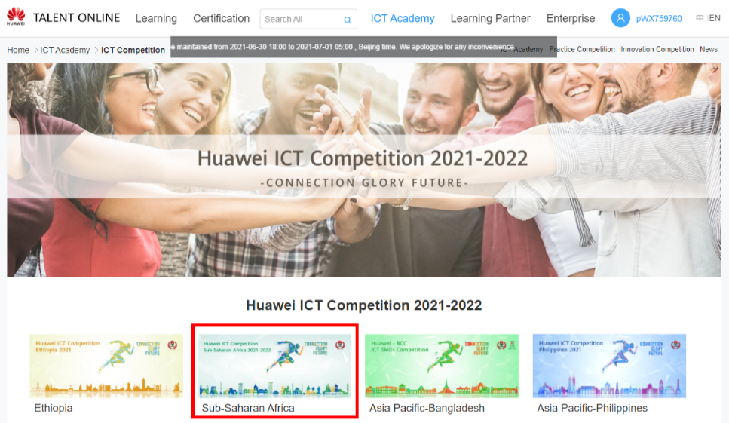
3. How to register for the competition(registered accounts)
1
5
2
3
4

Slide 4
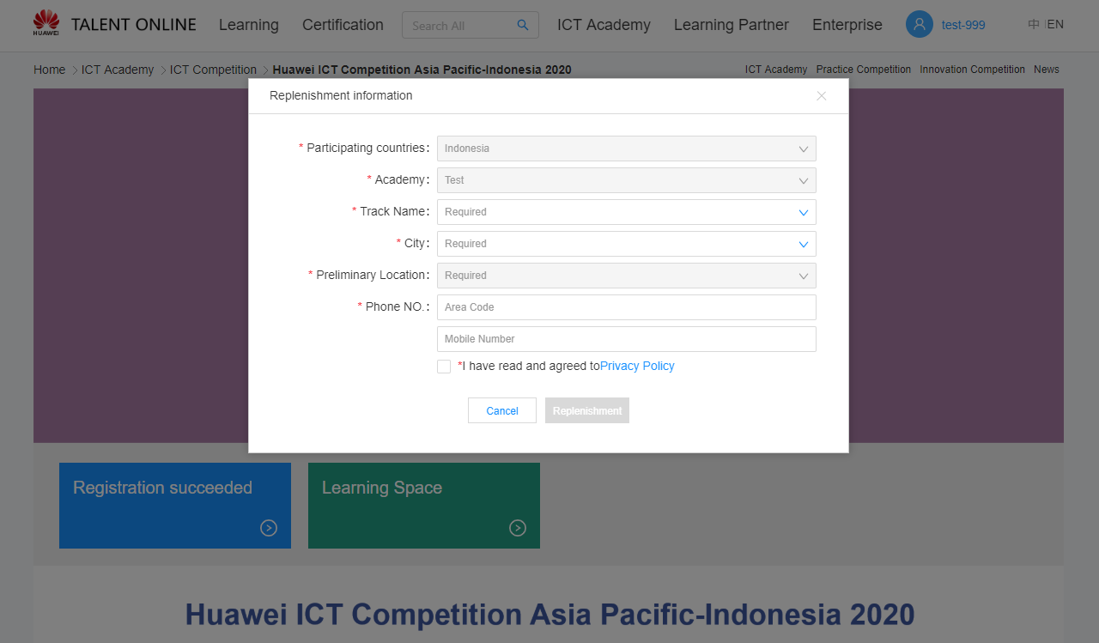
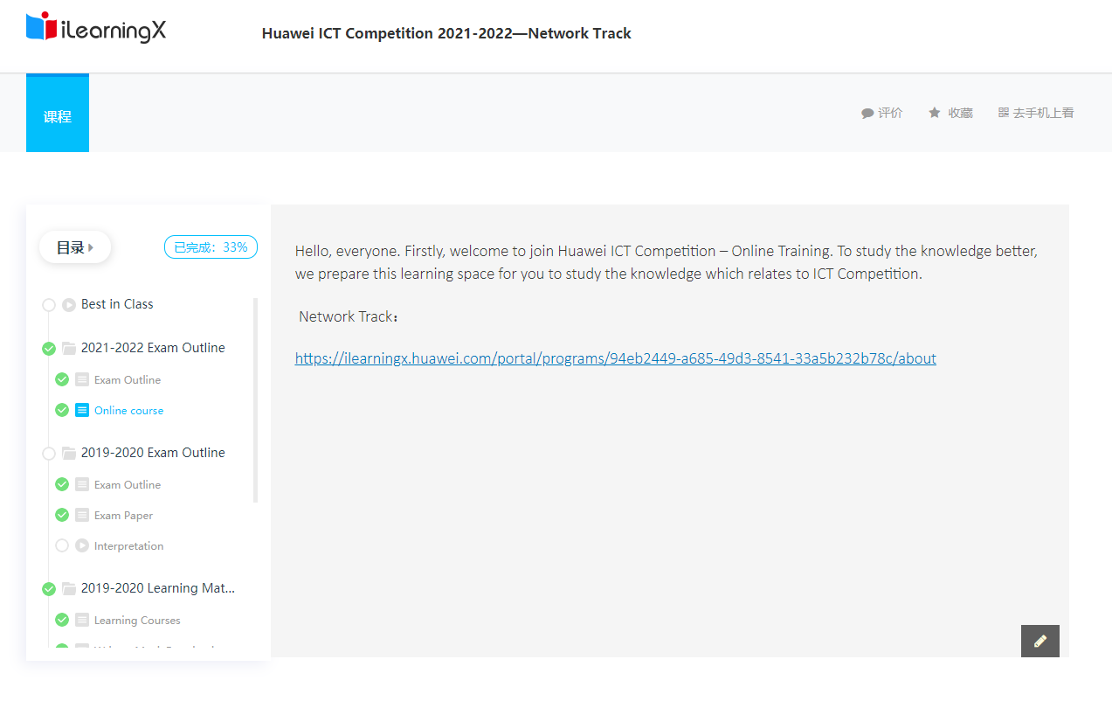
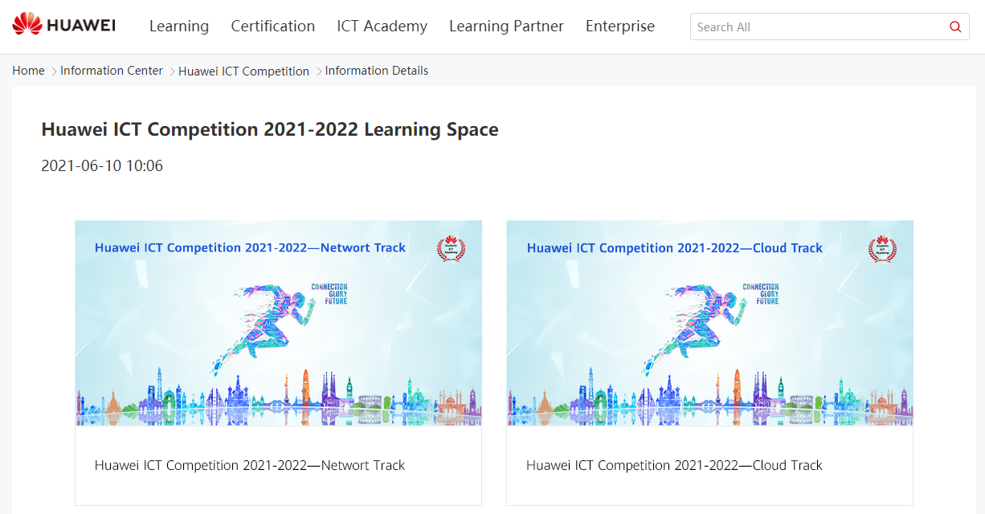
4. Replenishment Information
Complete your basic info and enter Learning Space
1
2
3
4
Choose your track

